Slide 1
Web Development:
Using Multiple Files in JavaScript

Slide 2
Recap: Adding jQuery
index.html
<head>
<script src="https://ajax.googleapis.com/ajax/libs/jquery/3.4.1/jquery.min.js"></script>
</head>
Notes:
As we learned at the beginning of this unit, jQuery is a JavaScript library that we can use in addition to regular JavaScript to improve the functionality of our sites and programs.

Slide 3
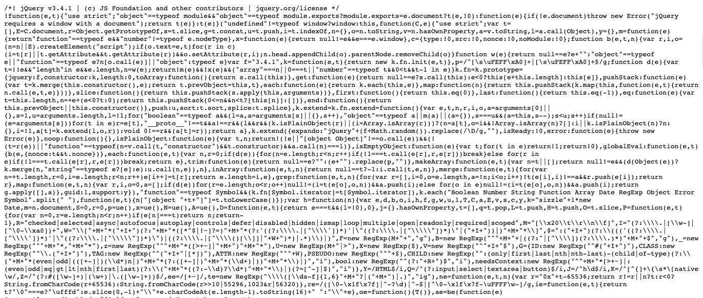
Recap: Adding jQuery
index.html
<head>
<script src="https://ajax.googleapis.com/ajax/libs/jquery/3.4.1/jquery.min.js"></script>
</head>
Notes:
jQuery is simply a JavaScript file that contains JavaScript code. When the file is added to the webpage, the file is executed.

Slide 4
The Wave
Notes:
In the final challenge exercise for the last unit, we were tasked with creating a recurring animation that occurred in sequential order.

Slide 5
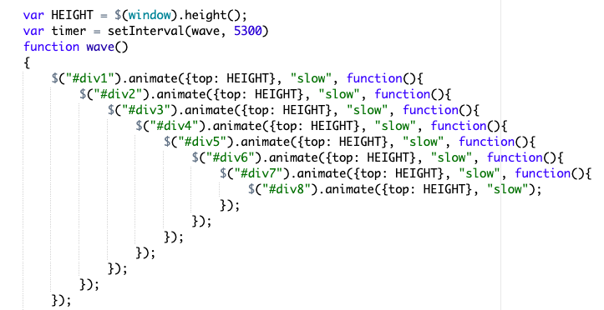
The Wave
Notes:
You may have noticed that this took quite a few lines of code to write.

Slide 6
The Wave
Including all this code in an HTML can be problematic!
Notes:
While writing all of this code is necessary for this program to execute correctly, including all of this code at the bottom of an HTML file can be problematic.

Slide 7
The Wave
Including all this code in an HTML can be problematic!
Clutters the file, which makes it harder to understand.
Notes:
For one, it clutters the file, which makes it harder to read. If we wanted to make adjustments to HTML, it becomes more difficult if we have to sift through a long document that includes multiple computing languages.

Slide 8
The Wave
Including all this code in an HTML can be problematic!
Clutters the file, which makes it harder to understand.
We have to rewrite the function in each html file we want to use it in.
Notes:
Secondly, it means that we have to rewrite this function each time we want to use it. For example, if we had another page on our website, and we wanted to run the same animation, we would have to copy and paste this program to every page that we wanted this animation to run. Copying the function to each webpage is not an efficient solution!

Slide 9
JavaScript Files
Just as we can load jQuery to our sites, we can add our own JavaScript files to a web page!
Notes:
Luckily, we can create our own js files! Just as we can load jQuery to our sites, we can add our own JS files to a web page!

Slide 10

JavaScript Files
Notes:
On CodeHS, we can create js file by using the create new file button located next to the index.html on exercises and in the Sandbox.

Slide 11

JavaScript Files
Notes:
When we click on this button

Slide 12
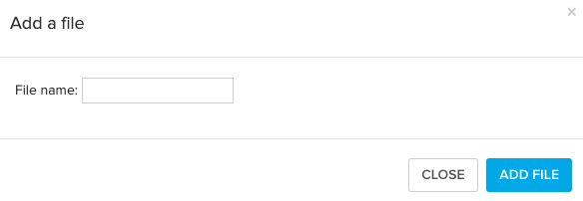
JavaScript Files
Notes:
it will direct us to a pop-up to create a new file.

Slide 13
JavaScript Files
JavaScript File names must be:
all lowercase
can include - or _
must end with .js
Notes:
To write a new file, we can write the name of the file in the file name input field. To write a JS file, the file name must be all lowercase, and end with .js. We can also include a dash or an underscore to separate words.

Slide 14
JavaScript Files
JavaScript File names must be:
all lowercase
can include - or _
must end with .js
my_file.js
Notes:
Here we will create a file called my_file.js. All of the text is lowercase, and the underscore is used to separate the two words for easier readability.

Slide 15
JavaScript Files
my_file.js
Notes:
Now we have a new file in our directory called my_file.js

Slide 16
JavaScript Files
my_file.js will open as an empty document.
my_file.js
Notes:
When we open that file, we will see it as an empty document.

Slide 17
JavaScript Files
Problem:
Our website has a button that appears on multiple pages and has the same purpose on each page. We don't want to write the function to execute the button on every page.
Notes:
We can now use this file to help address some of the issues that come with writing JS directly into an HTML page. For example, let's say we had a website that had a button that appeared on multiple pages. We don't want to write the function on every webpage - we want to create a function that can be used on all pages instead.

Slide 18
JavaScript Files
Problem:
Our website has a button that appears on multiple pages and has the same purpose on each page. We don't want to write the function to execute the button on every page.
Make Accessible
Notes:
Imagine this button was called Make Accessible.

Slide 19
JavaScript Files
Problem:
Our website has a button that appears on multiple pages and has the same purpose on each page. We don't want to write the function to execute the button on every page.
Increase text size, and darken the color of text.
Make Accessible
Notes:
When this button is clicked, it will make our web pages more accessible to users who may have sight problems. Clicking the button will increase text size, and darken the color of the text. Now that we have the functionality, let's try to figure out how to make this happen!

Slide 20
JavaScript Files
accessibility.js
Notes:
We are going to create a file called accessibility.js to indicate exactly what the purpose of the file is.

Slide 21
JavaScript Files
console.log("Initiate Accessibility Change");
accessibility.js
Notes:
As an initial test, we are going to include a call to the console that indicates the accessibility measures are going to begin. We can write our console.log message directly into the file as is.

Slide 22
JavaScript Files
accessibility.js
console.log("Initiate Accessibility Change");
index.html
<head>
</head>
<body>
<button id = access>Enhance</button>
</body>
Notes:
Next, we want to incorporate accessibility.js into our first web page.

Slide 23
JavaScript Files
accessibility.js
console.log("Initiate Accessibility Change");
index.html
<head>
<script src= "accessibility.js"></script>
</head>
<body>
<button id = access>Enhance</button>
</body>
Notes:
We can do so the same way that we add jQuery. We can create a script, and set the source of the script to equal the js file that we would like to be added and executed. In this case, we can write accessibility.js directly into the source because both files can be found in the same directory.

Slide 24

JavaScript Files
accessibility.js
console.log("Initiate Accessibility Change");
index.html
<head>
<script src= "accessibility.js"></script>
</head>
<body>
<button id = access>Enhance</button>
</body>
Notes:
When we click run code, or load this webpage now on to the browser, we can see that the console prints the Initiate Accessibility Change message from the JavaScript file, indicating that we have successfully loaded and executed the js file in our html file!

Slide 25
JavaScript Files
accessibility.js
console.log("Initiate Accessibility Change");
function makeAccessible()
{ console.log("First phase");
}
index.html
<head>
<script src= "accessibility.js"></script>
</head>
<body>
<button id = access>Enhance</button>
</body>
Notes:
Now let's begin adding the function makeAccessible, which will eventually be used to change the text on our site to be easier to read. To make sure this function works, we are going to add a console.log call "First Phase" to indicate that the function has executed.

Slide 26
JavaScript Files
accessibility.js
console.log("Initiate Accessibility Change");
function makeAccessible()
{ console.log("First phase");
}
index.html
<head>
<script src= "accessibility.js"></script>
</head>
<body>
<button id = access>Enhance</button>
</body>
Notes:
When we click run code again, we see that this call to the console doesn't show up.

Slide 27
JavaScript Files
accessibility.js
console.log("Initiate Accessibility Change");
function makeAccessible()
{ console.log("First phase");
}
This hasn't been called anywhere!
index.html
<head>
<script src= "accessibility.js"></script>
</head>
<body>
<button id = access>Enhance</button>
</body>
Notes:
This is because makeAccessible hasn't been called anywhere yet.

Slide 28
JavaScript Files
accessibility.js
console.log("Initiate Accessibility Change");
function makeAccessible()
{ console.log("First phase");
}
Anything that exists outside a function will execute immediately upon page load
index.html
<head>
<script src= "accessibility.js"></script>
</head>
<body>
<button id = access>Enhance</button>
</body>
Notes:
In a js file, anything that exists outside a function will execute immediately when the script has been loaded. Anything within a function will not be called until the function has been called.

Slide 29
JavaScript Files
accessibility.js
console.log("Initiate Accessibility Change");
function makeAccessible()
{ console.log("First phase");
}
index.html
<head>
<script src= "accessibility.js"></script>
</head>
<body>
<button id = access>Enhance</button>
<script>
makeAccessible();
</script>
</body>
Notes:
We can either call this function in the html file in a script tag.

Slide 30
JavaScript Files
accessibility.js
console.log("Initiate Accessibility Change");
makeAccessible();
function makeAccessible()
{ console.log("First phase");
}
index.html
<head>
<script src= "accessibility.js"></script>
</head>
<body>
<button id = access>Enhance</button>
</body>
Notes:
Or we can call it in the js file itself.

Slide 31
JavaScript Files
accessibility.js
console.log("Initiate Accessibility Change");
makeAccessible();
function makeAccessible()
{ console.log("First phase");
}
Where you call the function depends on its purpose!
index.html
<head>
<script src= "accessibility.js"></script>
</head>
<body>
<button id = access>Enhance</button>
</body>
Notes:
Where you call the function depends on its purpose. If the function relies on or uses other functions that have been written in a js file, it might make more sense to call it in the js file. If the function mostly affects HTML, then it may make more sense to include it in the HTML file itself.

Slide 32
JavaScript Files
console.log("Initiate Accessibility Change");
$("access").css("color", "green");
accessibility.js
We can even access other libraries/files in our external file!
Notes:
We can even access other libraries or files from our external file. Here, we've included the syntax from jQuery in our file, even though jQuery has not been loaded into the file. The use of this though, comes with some caveats - We can only use jQuery if it has been loaded to the html file, and loaded in the proper order.

Slide 33
JavaScript Files
The order that external files are loaded affects their usability:
accessibility.js
console.log("Initiate Accessibility Change");
$("access").css("color", "green");
index.html
<head>
<script src= "accessibility.js"></script>
<script src= "jquery.js"></script>
</head>
<body>
<button id = access>Enhance</button>
</body>
Notes:
The order in which external files are loaded, affects their usability. Here, we've loaded both the accessibility.js file and a jquery file that contains the scripts to run jQuery.

Slide 34
JavaScript Files
The order that external files are loaded affects their usability:
accessibility.js
console.log("Initiate Accessibility Change");
$("access").css("color", "green");
index.html
<head>
<script src= "accessibility.js"></script>
<script src= "jquery.js"></script>
</head>
<body>
<button id = access>Enhance</button>
</body>
Notes:
When we run this code, we run into an error. The console indicates that the keyword $ is not defined.

Slide 35
JavaScript Files
The order that external files are loaded affects their usability:
accessibility.js
console.log("Initiate Accessibility Change");
$("access").css("color", "green");
accessibility executes before jQuery has executed
index.html
<head>
<script src= "accessibility.js"></script>
<script src= "jquery.js"></script>
</head>
<body>
<button id = access>Enhance</button>
</body>
Notes:
This is because the accessibility file is trying to use the keyword $ before jQuery has been loaded to the page. Scripts execute in the order that they are added - so when accessibility is attempting to use jQuery, it is nowhere to be found!

Slide 36
JavaScript Files
The order that external files are loaded affects their usability:
accessibility.js
console.log("Initiate Accessibility Change");
$("access").css("color", "green");
If we change the order, this program no longer errors!
index.html
<head>
<script src= "jquery.js"></script>
<script src= "accessibility.js"></script>
</head>
<body>
<button id = access>Enhance</button>
</body>
Notes:
If we change the order that the scripts are loaded, we will no longer run into this error. This change though, comes with its own problem.

Slide 37
JavaScript Files
The order that external files are loaded affects their usability:
accessibility.js
console.log("Initiate Accessibility Change");
$("access").css("color", "green");
index.html
<head>
<script src= "jquery.js"></script>
<script src= "accessibility.js"></script>
</head>
<body>
<button id = access>Enhance</button>
</body>
Notes:
When we run the code, we anticipate that the text color of the button with the id access will change to green.

Slide 38
JavaScript Files
The order that external files are loaded affects their usability:
accessibility.js
console.log("Initiate Accessibility Change");
$("access").css("color", "green");
The button doesn't get styled correctly!
index.html
<head>
<script src= "jquery.js"></script>
<script src= "accessibility.js"></script>
</head>
<body>
<button id = access>Enhance</button>
</body>
Notes:
When this is run however, we can see that the button color is still black. What's going on here?

Slide 39
JavaScript Files
The order that external files are loaded affects their usability:
accessibility.js
console.log("Initiate Accessibility Change");
$("access").css("color", "green");
index.html
<head>
<script src= "jquery.js"></script>
<script src= "accessibility.js"></script>
</head>
<body>
<button id = access>Enhance</button>
</body>
The head loads before the body
Notes:
The issue that we are running into here is that the body of the webpage loads after the head. When a webpage loads, it loads linearly, meaning that the head will load and execute before the body of the webpage.

Slide 40
JavaScript Files
The order that external files are loaded affects their usability:
accessibility.js
console.log("Initiate Accessibility Change");
$("access").css("color", "green");
This executes before the button is loaded on the page
index.html
<head>
<script src= "jquery.js"></script>
<script src= "accessibility.js"></script>
</head>
<body>
<button id = access>Enhance</button>
</body>
Notes:
When an HTML page is loaded in the browser, the data in the head is loaded before the contents of the body. This means that the accessibility file loads and executes before the button access has been loaded to the page, preventing the button from being styled.

Slide 41
JavaScript Files
The order that external files are loaded affects their usability:
accessibility.js
console.log("Initiate Accessibility Change");
$("access").css("color", "green");
We should place scripts that interact with HTML at the bottom of the body
index.html
<head>
<script src= "jquery.js"></script>
</head>
<body>
<button id = access>Enhance</button>
<script src="accessibility.js"></script>
</body>
Notes:
We should place this script at the bottom of the body so that entirety of the body loads before the script executes.

Slide 42
JavaScript Files
The order that external files are loaded affects their usability:
accessibility.js
console.log("Initiate Accessibility Change");
$("access").css("color", "green");
We should place scripts that interact with HTML at the bottom of the body
index.html
<head>
<script src= "jquery.js"></script>
</head>
<body>
<button id = access>Enhance</button>
<script src="accessibility.js"></script>
</body>
Notes:
When this is run, we see that the button color is changed correctly, because the button was loaded onto the page, and then the script to execute the change.

Slide 43
JavaScript Files
The order that external files are loaded affects their usability:
console.log("Initiate Accessibility Change");
function makeAccessible()
{
$("access").css("color", "green");
}
accessibility.js
index.html
<head>
<script src= "jquery.js"></script>
<script src ="accessibility.js"></script>
</head>
<body>
<button id = access>Enhance</button>
<script>
makeAccessible();
</script>
</body>
Notes:
Alternatively, we could also place the command within a function, and call the function in a script at the end of the body. This ensures that the body of the page is loaded before the call to makeAccessible is made.

Slide 44
JavaScript Files
When should I place my script tag where?
Notes:
So when exactly should we worry about where the script that we've loaded is located?

Slide 45
JavaScript Files
When should I place my script tag where?
<head> : other scripts will need to utilize functions
<body> : scripts make changes to html/css
Notes:
As a general practice, we want to place scripts in the head that will be interacting with other js files. For example, we want jQuery loaded before the scripts in the body so that they can be successfully used.
We want to place scripts in the body that are going to be making changes to the html and css of a page. If an element needs to be loaded on to a page in order to be manipulated, then the script should follow the element!

Slide 46
Now it's Your Turn!
Notes:
Now that you've learned about js files, let's give it a try.

Slide 47
my_file.js | JavaScript files need to be written in all lowercase and end with .js. The use of - and _ is acceptable to separate words.

